Slide 1
Review of UML

Slide 2
Introduction
UML stands for Unified Modeling Language.
UML is different from the other common programming languages like C++, Java, COBOL etc.
UML is a pictorial language used to make software blue prints.
UML is a standard language for specifying, visualizing, constructing, and documenting the artifacts of software systems.
UML was created by Object Management Group and UML 1.0 specification draft was proposed to the OMG in January 1997.

Slide 3
Introduction
The OMG specification states:
"The Unified Modeling Language (UML) is a graphical language for visualizing, specifying, constructing, and documenting the artifacts of a software-intensive system. The UML offers a standard way to write a system's blueprints, including conceptual things such as business processes and system functions as well as concrete things such as programming language statements, database schemas, and reusable software components."

Slide 4
Goals of UML
A picture is worth a thousand words
to define some general purpose modeling language which all modelers can use and also it needs to be made simple to understand and use.

Slide 5
Conceptual Model of UML
To understand conceptual model of UML first we need to clarify What is a conceptual model? and Why a conceptual model is at all required?
A conceptual model can be defined as a model which is made of concepts and their relationships.
A conceptual model is the first step before drawing a UML diagram. It helps to understand the entities in the real world and how they interact with each other.
As UML describes the real time systems, it is very important to make a conceptual model and then proceed gradually.
Conceptual model of UML can be mastered by learning the following three major elements:
UML building blocks
Rules to connect the building blocks
Common mechanisms of UML

Slide 6
Relation of UML with OO
The relation between OO design and UML is very important to understand.
The OO design is transformed into UML diagrams according to the requirement.
Before understanding the UML in details the OO concepts should be learned properly.
Once the OO analysis and design is done the next step is very easy.
The input from the OO analysis and design is the input to the UML diagrams.
class diagram, object diagram, collaboration diagram, interaction diagrams all would basically be designed based on the objects.

Slide 7
Building blocks of UML
Things
Relationships
Diagrams

Slide 8
Building blocks of UML
Things:
are the most important building blocks of UML. Things can be:
Structural
Behavioral
Grouping
Annotational
Structural:
define the static part of the model.
They represent physical and conceptual elements.

Slide 9
Building blocks of UML
Structural:
Class:
represents set of objects having similar responsibilities.
Interface:
defines a set of operations which specify the responsibility of a class.
Collaboration:
defines interaction between elements.
Use case:
represents a set of actions performed by a system for a specific goal.
Component:
describes physical part of a system.
Node:
physical element that exists at run time.

Slide 10
Building blocks of UML
Behavioral:
consists of the dynamic parts of UML models.
Interaction:
defined as a behavior that consists of a group of messages exchanged among elements to accomplish a specific task.
State Machine:
defines the sequence of states an object goes through in response to events.
is useful when the state of an object in its life cycle is important.

Slide 11
Building blocks of UML
Group:
can be defined as a mechanism to group elements of a UML model together.
Package:
is the only one grouping thing available for gathering structural and behavioral things.
Annotational:
can be defined as a mechanism to capture remarks, descriptions, and comments of UML model elements.
Note:
is used to render comments, constraints etc of an UML element.

Slide 12
Building blocks of UML
Relationships:
another most important building block of UML.
It shows how elements are associated with each other and this association describes the functionality of an application.
Different kinds of relationship are:
Dependency
is a relationship between two things in which change in one element also affects the other one.

Slide 13
Building blocks of UML
Association:
is basically a set of links that connects elements of an UML model.
It also describes how many objects are taking part in that relationship.
Generalization:
can be defined as a relationship which connects a specialized element with a generalized element.
It basically describes inheritance relationship in the world of objects.
Realization:
can be defined as a relationship in which two elements are connected.
One element describes some responsibility which is not implemented and the other one implements them.
This relationship exists in case of interfaces.

Slide 14
Building blocks of UML
UML Diagram:
All the elements, relationships are used to make a complete UML diagram and the diagram represents a system.
The visual effect of the UML diagram is the most important part of the entire process. All the other elements are used to make it a complete one.
Different UML diagrams are
Class diagram
Object diagram
Use case diagram
Sequence diagram
Collaboration diagram
Activity diagram
State chart diagram
Deployment diagram
Component diagram

Slide 15
UML plays an important role in defining different perspectives of a system.
These perspectives are:
Design
Implementation
Process
Deployment
And the centre is the Use Case view which connects all these four.
A Use case represents the functionality of the system. So the other perspectives are connected with use case.
Design of a system consists of classes, interfaces and collaboration.
UML provides class diagram, object diagram to support this.
Implementation defines the components assembled together to make a complete physical system.
UML component diagram is used to support implementation perspective.
Process defines the flow of the system.
So the same elements as used in Design are also used to support this perspective.
Deployment represents the physical nodes of the system that forms the hardware.
UML deployment diagram is used to support this perspective.

Slide 16
UML Modeling Types
Structural Modeling
captures the static features of a system
represents the framework for the system and this framework is the place where all other components exist.
never describes the dynamic behavior of the system.
Consists of
Classes diagrams
Objects diagrams
Deployment diagrams
Package diagrams
Composite structure diagram
Component diagram

Slide 17
UML Modeling Types
Behavioral Modeling
describes the interaction in the system.
It represents the interaction among the structural diagrams.
Behavioral modeling shows the dynamic nature of the system.
Consists of
Activity diagrams
Interaction diagrams
Use case diagrams

Slide 18
UML Modeling Types
Architectural Modeling
represents the overall framework of the system.
It contains both structural and behavioral elements of the system.
Architectural model can be defined as the blue print of the entire system.
Package diagram comes under architectural modeling.

Slide 19
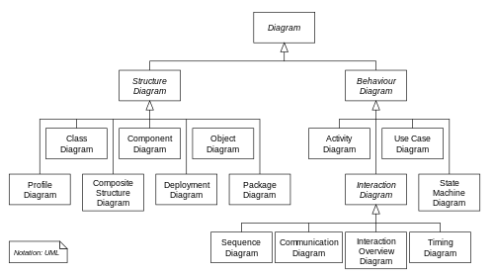

Slide 20
Class Diagram
is a static diagram.
represents the static view of an application.
Class diagram is not only used for visualizing, describing and documenting different aspects of a system but also for constructing executable code of the software application.
The class diagram describes the attributes and operations of a class and also the constraints imposed on the system.
The class diagrams are widely used in the modeling of object oriented systems because they are the only UML diagrams which can be mapped directly with object oriented languages.
The class diagram shows a collection of classes, interfaces, associations, collaborations and constraints. It is also known as a structural diagram.
Purpose:
Analysis and design of the static view of an application.
Describe responsibilities of a system.
Base for component and deployment diagrams.
Forward and reverse engineering.

Slide 21
Class Diagram
How to draw?
The name of the class diagram should be meaningful to describe the aspect of the system.
Each element and their relationships should be identified in advance.
Responsibility (attributes and methods) of each class should be clearly identified.
For each class minimum number of properties should be specified. Because unnecessary properties will make the diagram complicated.
Use notes when ever required to describe some aspect of the diagram. Because at the end of the drawing it should be understandable to the developer/coder.
Finally, before making the final version, the diagram should be drawn on plain paper and rework as many times as possible to make it correct.

Slide 22
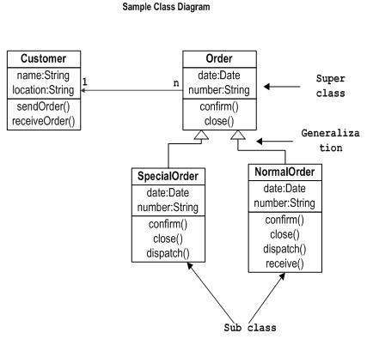
Class Diagram

Slide 23
Object Diagram
represent an instance of a class diagram.
are used to render a set of objects and their relationships as an instance.
The difference between class and object diagram is that a class diagram represents an abstract model consisting of classes and their relationships. But an object diagram represents an instance at a particular moment which is concrete in nature.
Purpose:
Forward and reverse engineering.
Object relationships of a system
Static view of an interaction.
Understand object behavior and their relationship from practical perspective

Slide 24
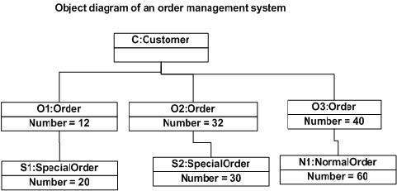
Object Diagram

Slide 25
Use case Diagram
is dynamic in nature there should be some internal or external factors for making the interaction.
internal and external agents are known as actors.
So use case diagrams are consists of actors, use cases and their relationships.
The diagram is used to model the System/subsystem of an application.
A single use case diagram captures a particular functionality of a system.
Purpose:
Used to gather requirements of a system.
Used to get an outside view of a system.
Identify external and internal factors influencing the system.
Show the interacting among the requirements are actors.

Slide 26
Use case Diagram
How to draw???
Functionalities to be represented as an use case
Actors
Relationships among the use cases and actors.
Then:
The name of a use case is very important. So the name should be chosen in such a way so that it can identify the functionalities performed.
Give a suitable name for actors.
Show relationships and dependencies clearly in the diagram.
Do not try to include all types of relationships. Because the main purpose of the diagram is to identify requirements.
Use note when ever required to clarify some important points.

Slide 27
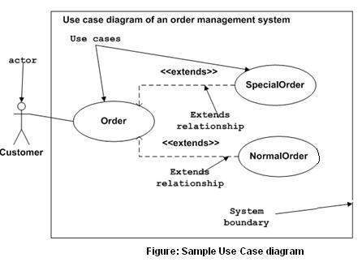
Use case Diagram

Slide 28
Interaction Diagram
is used to describe some type of interactions among the different elements in the model.
Represents dynamic behavior.
interactive behavior is represented in UML by two diagrams known as Sequence diagram and Collaboration diagram.
The basic purposes of both the diagrams are similar.
Sequence diagram emphasizes on time sequence of messages and collaboration diagram emphasizes on the structural organization of the objects that send and receive messages.
Purpose:
To capture dynamic behavior of a system.
To describe the message flow in the system.
To describe structural organization of the objects.
To describe interaction among objects.

Slide 29
How to draw??
Identify
Objects taking part in the interaction.
Message flows among the objects.
The sequence in which the messages are flowing.
Object organization.

Slide 30
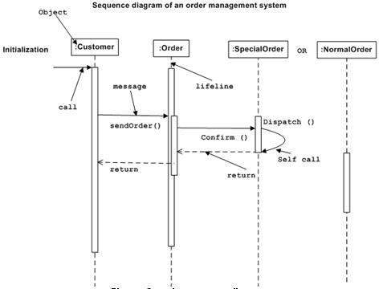
Sequence Diagram

Slide 31
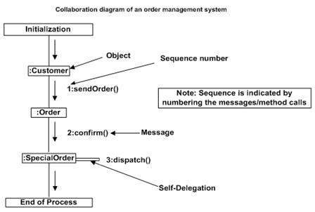
Collaboration Diagram

Slide 32
State Chart Diagram
describes different states of a component in a system.
The states are specific to a component/object of a system.
A State-chart diagram describes a state machine.
Purpose:
To model dynamic aspect of a system.
To model life time of a reactive system.
To describe different states of an object during its life time.
Define a state machine to model states of an object.

Slide 33
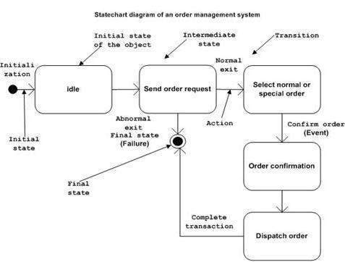
State Chart Diagram
How to draw??
Identify important objects to be analyzed.
Identify the states.
Identify the events.

Slide 34
Activity Diagram
is basically a flow chart to represent the flow form one activity to another activity.
Purpose:
Draw the activity flow of a system.
Describe the sequence from one activity to another.
Describe the parallel, branched and concurrent flow of the system.
How to draw??
Identify
Activities
Association
Conditions
Constraints

Slide 35
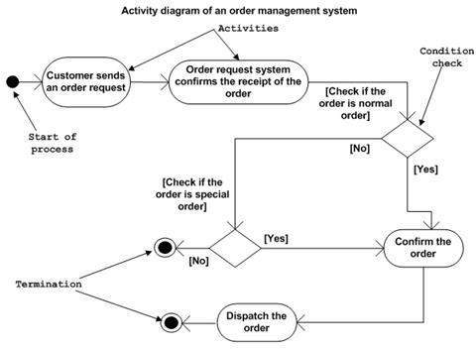
Activity Diagram

